Slide 1
Spatial Pattern of Electric Vehicles Charging Station in NYC
Yiqi Jian

Slide 2
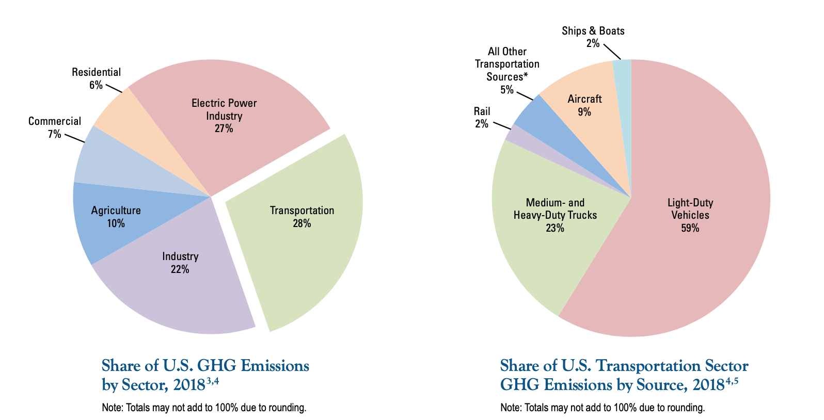
Background
Transportation sector contributes to 28% of the Greenhouse gas Emissions
Light-Duty Vehicles contributes 59% in that 28%
NYC plan to increase the number of EV to fight for climate change
A better charging network required to achieve goals
Determine spatial pattern of current EV charging stations
Shows potential locations for building new EV charging stations
Figure 1: share of U.S. GHG Emissions by sector in 2018 (EPA, 2020).

Slide 3

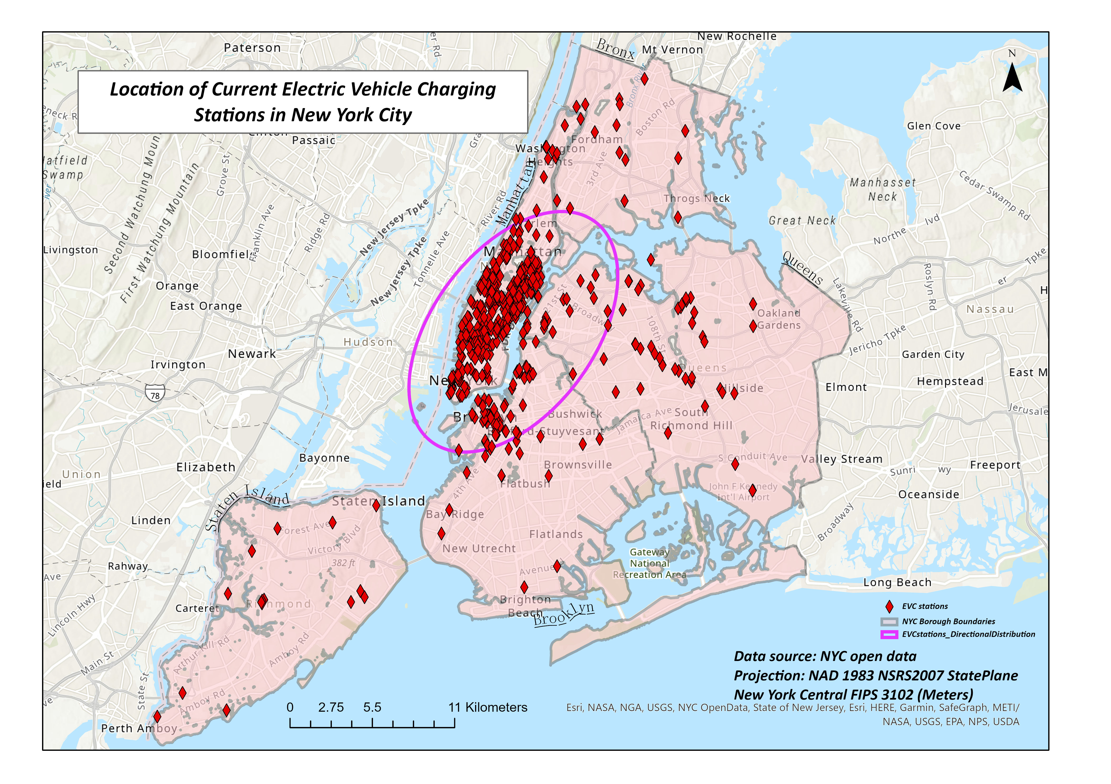

Method & Data
Data acquired from NYC open data
GIS Method
Density Analysis (Dasymetric Mapping)
Directional Distribution (Standard Deviation Ellispe)
Multi-Distance Spatial Cluster Analysis (Ripley’s K Function)
Proximity Analysis (Euclidean Distance)
Areal Interpolation (Weighted Overlay)
Figure 2: The location of existing electric vehicle charging stations in New York City.

Slide 4
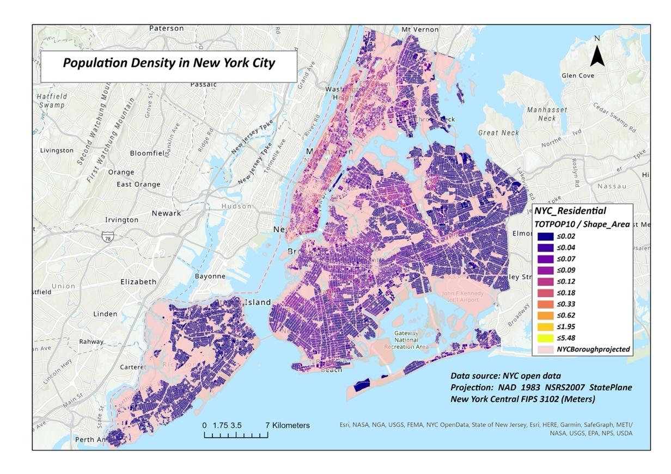
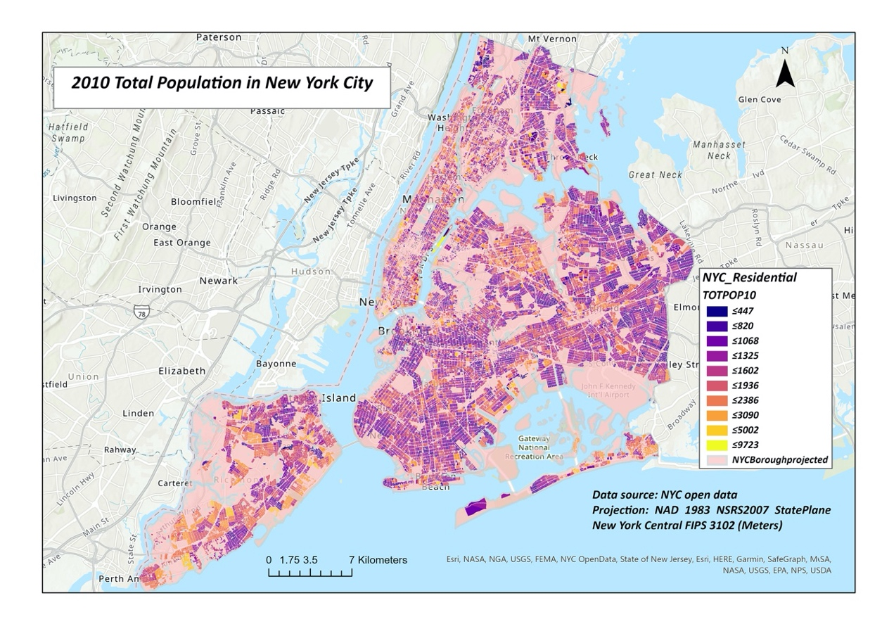
Result – Density Analysis
Figure 3: the dasymetric map showing population density in New York City. Population density is higher in the Manhattan and Bronx area.
Figure 4: The total population in New York City. Population is higher in city centre, lower in rural area.

Slide 5
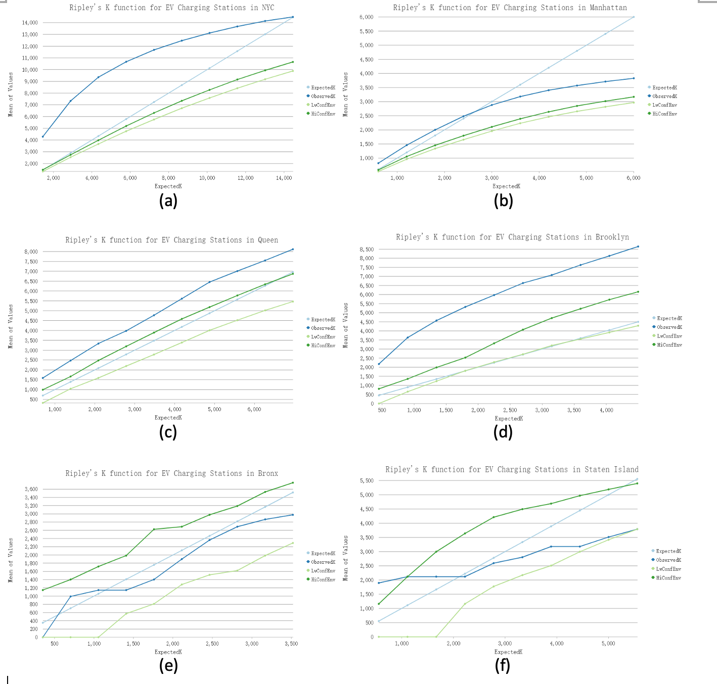
Result – Ripley’s K function
For the whole NYC area, Ripley‘s k function shows a cluster spatial pattern for the data set.
In Manhattan, Queen, Brooklyn, the spatial pattern is cluster
In Bronx and Staten Island, the spatial pattern is more uniform
Less than 30 input features in Bronx and Staten Island, not ideal for Multi-distance cluster analysis
Figure 6: The Ripley’s K function graph for different borough in the New York City.

Slide 6
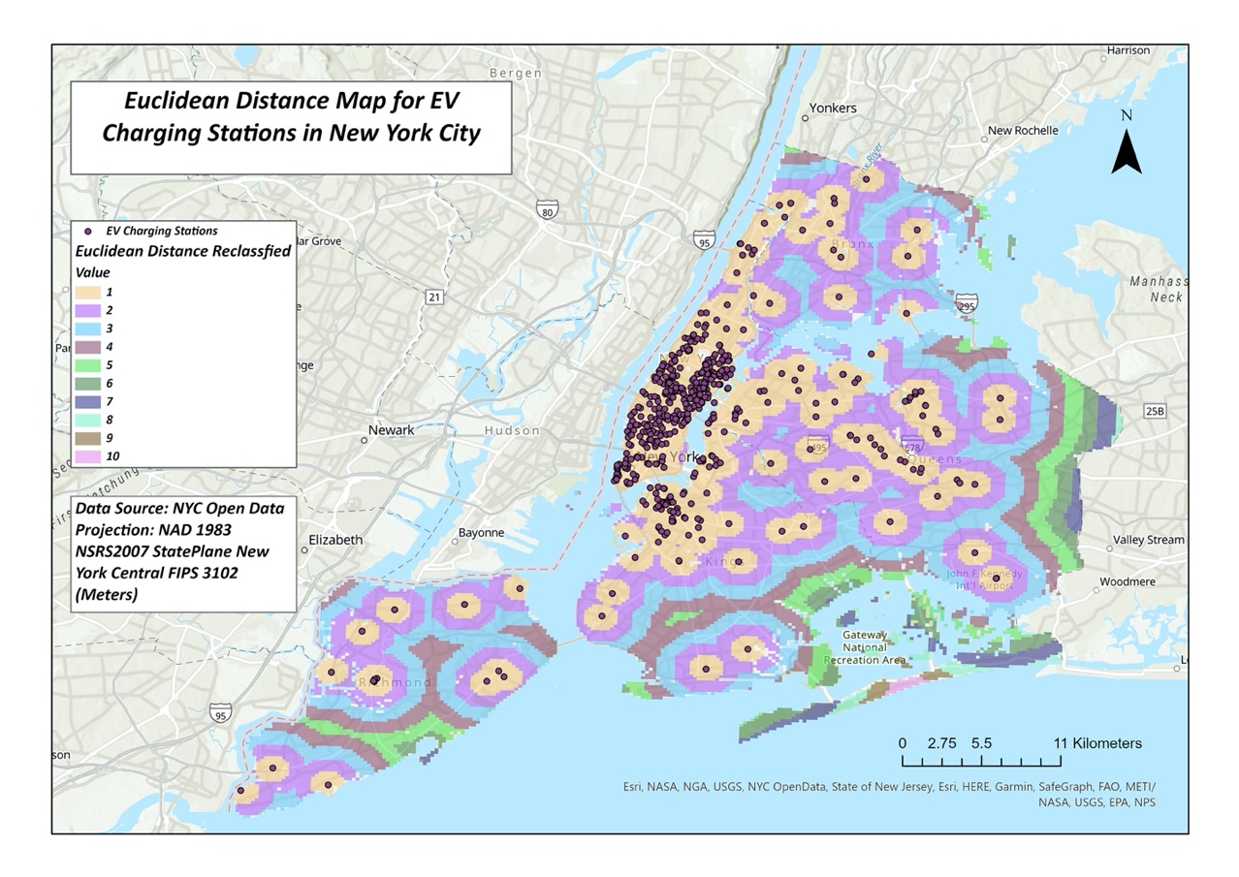
Result – Proximity Analysis
Reclassified
Higher value represent further distance from a existing EV charging station
High value located at the edge of study area boundary
Edge Effect
Figure 7: the Euclidean distance for the existing EV charging stations in New York City.

Slide 7
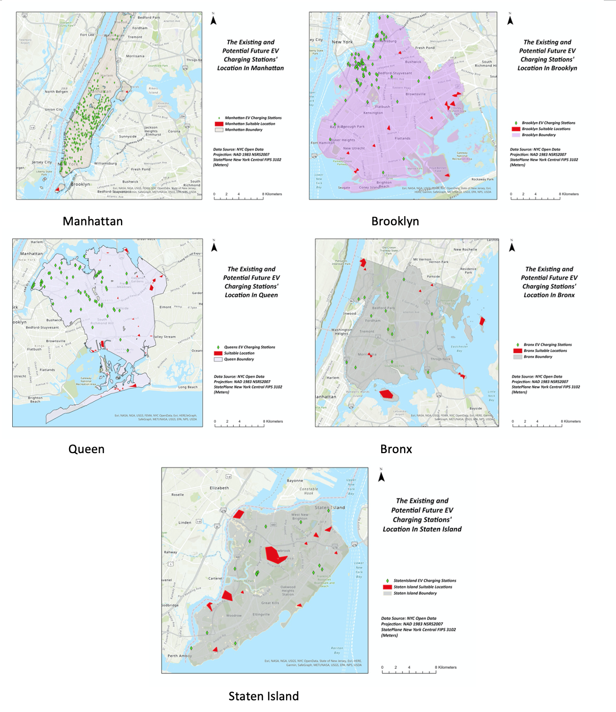
Result – Weighted Overlay
Total area of 8.7km² in NYC suitable for building new stations
Manhattan & Brooklyn has higher number of current stations, less space for building new one
Queen, Bronx, Staten Island has more space to build
Borough | Current EVC Stations | Number of polygon | Total Area (m²) | Area (%)
NYC | 531 | 71 | 8722530.41 | 100%
Queen | 65 | 31 | 2759961.15 | 31.6%
Bronx | 15 | 12 | 1560514.95 | 17.9%
Brooklyn | 80 | 14 | 587283.58 | 6.73%
Manhattan | 355 | 2 | 116768.89 | 1.34%
Staten Island | 16 | 12 | 3698001.83 | 42.4%
Figure 8: The suitable locations for EVC stations in the New York City.

Slide 8

Conclusion
The spatial pattern of EV charging station in NYC is clustered
New EV charging station can build in Queen, Bronx, and Staten Island
Require further study on consumer preference, policy legislation and real world implication

Slide 9
Reference
Funke, S. A., Sprei, F., Gnann, T., Plotz, P. (2019). How much charging infrastructure do electric vehicles need? A review of the evidence and international comparison. Transportation Research Part D 77 (2019) 224-242. https://doi.org/10.1016/j.trd.2019.10.024
Hardsman, S., Jenn, A., Tal, G., Axsen, J., Beard, G., Daina, N., Figenbaum, E., Jakobsson, N., Jochem, P., Kinnear, N., Plotz, P., Pontes, J., Refa, N., Sprei, F., Turrentine, T., Witkamp, B. (2018). A review of consumer preferences of and interactions with electric vehicle charging infrastructure. Transportation Research Part D 62 (2018) 508-523. https://doi.org/10.1016/j.trd.2018.04.002.
Henry, A., Bonges III., Anne C. L. (2016). Addressing electrc vehicle (EV)sales and range anxiety through parking layout, policy and regulation. Transportation Research Part A 83 (2016) 63-73. https://doi.org/10.1016/j.tra.2015.09.011
Hundt, R., Schub, J. New York State Energy and Development Authority. (2015). Review of New York State Electric Vehicle Charging Station Market and Policy, Finance, and Market Development Solutions. Coalition for Green Capital.
United States Emission Protection Agency (EPA). (2020). Fast Facts: U.S. Transportation Sector Greenhouse Gas Emissions 1990-2018. Office of Transportation and Air Quality.

